Slide 1

Server Virtualization

Slide 2

Objectives
Describe the need for virtualization on servers
Identify the usage of server virtualization.
Identify 2 types of hypervisors
Identify the 3 different types of virtualization
Describe the types of advanced virtual machine operations used in server management.
Understand how virtual machine scalability is achieved.
Describe how networks in virtual servers are connected

Slide 3
What is Server Virtualization?
We refer to system virtual machines today.
Virtualization is a way that enables multiple ‘virtual’ computers to operate within a single hardware instance.
Each virtual machine runs a separate operating system instance which can be different.
Each of these virtual machine shares physical resources (CPU, memory, disk, network) on the physical machine.
Notes:
Virtualization happens on different levels –
Software virtualization – Recall your Java Virtual Machine -> apps can run anywhere, independent of OS!

Slide 4
Why the need for virtualization?
Effective Resource Usage –
Resources (RAM/CPU/DISK) can be allocated wherever needed.
Ease of Management -
Unused machines can be kept indefinitely off until when required, and do not consume any resources other than disk space.
Application provisioning, maintenance, high availability and disaster recovery
Security –
Applications can be kept on separate servers.
Separate servers do not pose a risk to each other
Especially true when virtual machines are owned by mutually untrusting users.

Slide 5
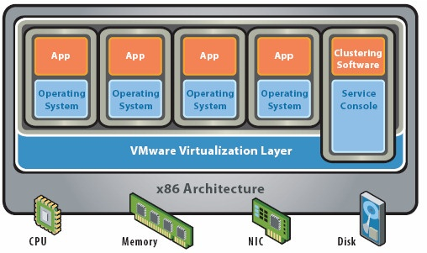
The role of the hypervisor
Hypervisors (Virtual Machine Monitor / VMM ) sit between virtual machines and the hardware.
Divides a single physical server for multiple operating systems to interact with the underlying hardware
Allocates and provides resources and hardware to access to the virtual machines it serves.

Slide 6
Hypervisor Classifications
Type 1 "bare-metal" hypervisor. This is a hypervisor that sits underneath the operating system on the bare metal of the server hardware itself. Type 1 hypervisor runs directly on the hardware. VMware vSphere Hypervisor is a Type 1 hypervisor, as is Xen.
Type 2 hypervisor, which runs on top of a "host" OS such as Windows or Linux. Parallels Workstation, like VMware Player/ Workstation , sits on top of a host OS. Type 2 hypervisor runs on another operating system, such as Linux. Vmware Workstation is a Type 2 hypervisor

Slide 7
Types of Virtualization
Total of 3 types currently
Paravirtualization – (Same Hardware)
Full Virtualization – (Emulated Hardware)
Recently CPU manufacturers Intel and AMD came with distinct implementations of hardware-assisted x86 virtualization, Intel VT and AMD-V, to extend the performance of Full- Virtualization.
Hardware Assisted Virtualization - (Emulated Hardware)
Notes:
List of processors supporting VTX - http://ark.intel.com/VTList.aspx

Slide 8
Server Virtualization Scenarios
App
App
Hardware-based virtualization
Software-based virtualization
Hosted (application virtualization)
Hypervisor
Full virtualization (binary translation)
Para-virtualization (OS assisted)
Hardware-assisted virtualization (Intel VT-x/AMD-V)
Guest OS
Guest OS
Virtualization
Software
Host Operating System
X86 Hardware
App
App
Guest OS
Guest OS
Mgmt
Partition
Hypervisor
X86 Hardware

Slide 9
Common Hypervisors & Types of Virtualization
Windows 2008 / 2008 R2 (64 bit only)
Base OS includes hypervisor/ Emulated Hardware for VMs
Hypervisor runs on top of host Operating System.
Linux Open Source Virtualization – Choice of 2
Xen (para-virtualized – same hardware as host)
KVM (Hardware Assisted -/ Emulated Hardware for VMs )
Commercial Hypervisors
VMware vSphere
VMWare vSphere Hypervisor (ESXi)
VMWare Workstation

Slide 10
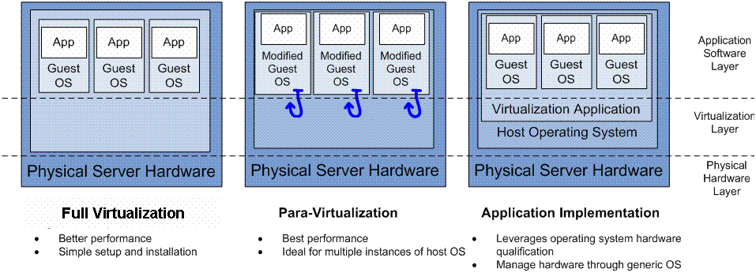
Software-Based Virtualization (Examples)
Hypervisor
Hypervisor
Full Virtualization
Para-Virtualization
Application Virtualization
Examples
Examples
Examples
VMware ESX server
Microsoft HyperV
Xen (with AMD-SVM or Intel VM-T)
Virtuallron (hardware-assisted)
Xen (with traditional hardware)
Oracle VM server
VMware server
VMware workstation

Slide 11
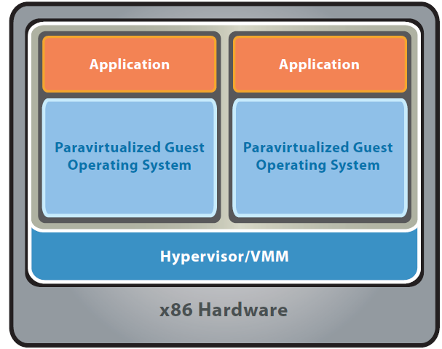
Paravirtualization
OS Assisted Virtualization
Requires a modified version of the virtualized operating system
Conventional O/S not paravirtualization-aware cannot run on top of a paravirtualized hypervisor (eg windows)
Performance improves by having the guest operating system communicate with the hypervisor.
Each guest VM can cooperate to obtain better performance when running in a virtual machine
VM does NOT simulate hardware
VM Sees Same hardware as in host OS

Slide 12
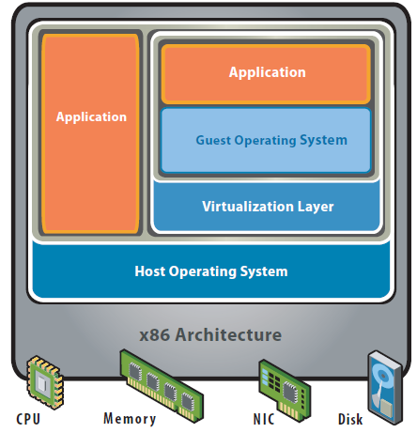
Full Virtualization
Requires a normal host operating system
Virtualization layer sits on top of host operating software. (eg Sun virtualbox)
Presents a Virtual Machine environment that is a complete simulation of the underlying hardware (does not have to be identical)
Guest OS can run if they are compatible with the underlying hardware architecture.
Notes:
(eg x86 hardware, Linux 32 bit host OS, Windows XP 32 bit in the VM)

Slide 13
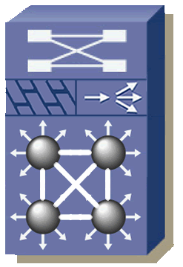





Hardware Assisted Virtualization
Hardware-assisted virtualization is a virtualization approach that enables efficient full virtualization using help from hardware capabilities, primarily from the host processors.
Front-End Virtualization
VLAN
VRF
VDC
VSS
VPNs
Front-End
Virtual Network Services
Virtual Firewall Context
1
Virtual
SSL Context
3
Virtual Firewall Context
1
Virtual Firewall Context
1
Virtual
SLB Context
29
Virtual
SSL Context
3
Virtual
SSL Context
175
Virtual Machines
Virtual SANs/Unified IO
Back-End
VSANs
vHBA
CNA
FCoE
Virtual Storage
Notes:
“Hardware-assisted virtualization is a virtualization approach that enables
efficient full virtualization using help from hardware capabilities, primarily
from the host processors.” Full virtualization is used to simulate a complete
hardware environment, or virtual machine, in which an unmodified “guest” operating
system (using the same instruction set as the host machine) executes in
complete isolation. Hardware-assisted virtualization was first implemented on the
IBM® System/370®, and was recently (2007) added to x86 processors (Intel VT®
or AMD-V®).
According to Gartner, “Virtualization is the highest impact trend changing
infrastructure and operations through 2012. It will change how you manage,
how and what you buy, how you deploy, how you plan, and how you charge
[36].” Several studies by the research firm IDC also support this claim. The firm
reports 22 percent of servers today as being virtualized and expects that number
to grow to 45 percent over the next 12 to 18 months [37]. Another IDC study
predicts that the number of logical servers generated on virtualized servers will
surpass the number of non-virtualized physical server units by 2010 [38].
Examples of virtualization solutions in X86-based processor systems include
VMware® vSphere/ESX®, Microsoft Hyper-V®, Linux® KVM®, and Linux® Xen®.
With efficient hardware-assisted virtualization, multiple low-usage servers can be
virtualized (i.e., transformed into a Virtual Machine) and multiple VMs can be
run simultaneously on the same physical server. VMs can also be moved from one
server to another for load balancing or disaster recovery.
Organizations worldwide are already beginning to take advantage of this model.
The 2007 IDC study, for example, showed that 50% of all VMware ESX® users
had adopted VMotion capability [39]. This technology enables live migration—
moving guests from one physical server to another with no impact to end users’
experience. By giving IT managers the ability to move guests on the fly, live migrations
make it easier to balance workloads and manage planned and unplanned
downtimes more efficiently.
UCS, with its large memory footprint and native virtualization support, may help
cut the number of servers by one order of magnitude, thus achieving an even
larger power saving.

Slide 14
Hardware Assisted Virtualization
Full virtualization (presenting the illusion of a complete set of standard hardware) on x86 has significant costs in hypervisor complexity and run-time performance.
Same as Full Virtualization, however the Guest VM can communicate directly with the hardware bypassing the hypervisor for certain machine instructions.
Explicit hardware support in the host CPU must be present.
Hardware-Assisted CPU Virtualization (Intel VT-x and AMD AMD-V)
Hardware-Assisted MMU Virtualization (Intel EPT and AMD RVI)
Hardware-Assisted I/O MMU Virtualization (Intel VT-d and AMD AMD-Vi)

Slide 15
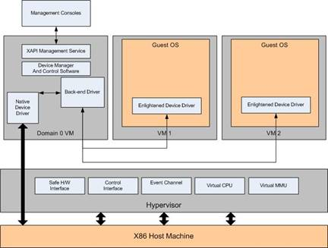
Hardware Assisted Virtualization
These extensions address the parts of x86 that are difficult or inefficient to virtualize, providing additional support to the hypervisor. This enables simpler virtualization code and a higher performance for full virtualization.
Offers some speed improvements as instructions handled in hardware as compared to software (hypervisor)

Slide 16
Enabling Hardware Assisted Virtualization - CPU
First-generation hardware support for x86 virtualization with AMD-Virtualization™ (AMD-V™) and Intel® VT-x technologies in 2006
Requires Hardware Data Execution Prevention : prevent an application or service from executing code from a non-executable memory region. This helps prevent certain exploits that store code via a buffer overflow, for example.
Intel VT-x (initially codenamed Vanderpool)
Intel refers to it as Execute Disable (XD). This feature must be enabled in the system BIOS.
AMD AMD-V (also called SVM and initially codename Pacifica)
AMD refers to it as No Execute (NX). This feature must be enabled in the system BIOS.
When you enable hardware assisted virtualization (Intel VT or AMD AMD-V) in the BIOS, you must POWER CYCLE the system.

Slide 17
Enabling Hardware Assisted Virtualization - MMU
Intel introduced its second generation of hardware support that incorporates Memory Management Unit (MMU) virtualization, called Extended Page Tables (EPT). AMD also introduced its own MMU virtualization, called Rapid Virtualization Indexing (RVI) or Nested Page Tables (NPT)
EPT/RVI -enabled systems can improve performance compared to using native shadow paging for MMU virtualization.
EPT provides performance gains of up to 48% for MMU-intensive benchmarks and up to 600% for MMU-intensive microbenchmarks
RVI provides performance gains of up to 42% for MMU-intensive benchmarks and up to 500% for MMU-intensive microbenchmarks
VMM can now rely on hardware to eliminate the need for shadow page tables. This removes much of the overhead otherwise incurred to keep the shadow page tables up-to-date
Turn these features on in BIOS to enable.
Notes:
http://www.vmware.com/pdf/Perf_ESX_Intel-EPT-eval.pdf
http://www.vmware.com/pdf/RVI_performance.pdf

Slide 18
Enabling Hardware Assisted Virtualization – I/O
An even newer processor feature is an I/O memory management unit that remaps I/O DMA transfers and device interrupts. This can allow virtual machines to have direct access to hardware I/O devices, such as network cards.
In AMD processors this feature is called AMD I/O Virtualization (AMD-Vi or IOMMU) and in Intel processors the feature is called Intel Virtualization Technology for Directed I/O (VT-d).
In VMWare, VMDirectPath I/O leverages Intel VT-d and AMD-Vi hardware support to allow guest operating systems to directly access hardware devices. In the case of networking, VMDirectPath I/O allows the virtual machine to access a physical NIC directly rather than using an emulated device (E1000) or a para-virtualized device
While VMDirectPath I/O has limited impact on throughput, it reduces CPU cost for networking-intensive workloads
Notes:
http://www.vmware.com/pdf/Perf_Best_Practices_vSphere4.1.pdf

Slide 19
Key Properties of Virtual Machines
Partitioning
Run multiple operating systems on one physical machine
Divide system resources between virtual machines
Isolation
Fault and security isolation at the hardware level
Advanced resource controls preserve performance
Encapsulation
Entire state of the virtual machine can be saved to files
Move and copy virtual machines across hosts as easily as moving and copying files
Hardware Independance
Provision or migrate any virtual machine to any similar or different physical server

Slide 20
VMWare Type 1 and Type 2 offerings
 | VMware Player | VMware Workstation | VMware vSphere Hypervisor (ESXi) | VMware vSphere
Hypervisor Type | Hosted | Hosted | Bare Metal | Bare Metal
Typical Use Case | Test | Test & Dev | Production, Test & Dev | Tier 1 apps, Production, Test & Dev
# of VMs per host | 1-2 | < 10 | < 10 | > 10
Dedicated Server Required | No | No | Yes | Yes
Centralized Management | No | No | No | Yes

Slide 21
VMWare Type 1 and Type 2 offerings
 | VMware Player | VMware Workstation | VMware vSphere Hypervisor (ESXi) | VMware vSphere
Remote Management | No | No | Yes | Yes
Headless Operation | No | Yes | Yes | Yes
Support Available | No | Yes | Yes | Yes
Transition Path to VMware vSphere | Easy. Convert virtual machines to run on vSphere using VMware converter. | Easy. Drag and drop to upload virtual machines to VMware vSphere. | Easiest. Virtual machines and hypervisor are compatible with paid editions of vSphere. | N/A
Pricing | Free | Paid | Free | Paid

Slide 22
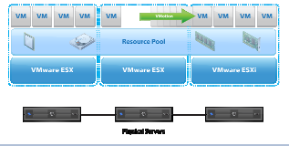
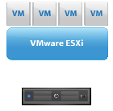
Comparing ESXi to VMware vSphere
VMware vSphere Hypervisor (ESXi)
Single server partitioning
Production-class hypervisor
Advanced server resource management
FREE
VMware vSphere
Pools of computing resources
Centralized management
Built-in automation, availability and manageability
All Editions include ESXi

Slide 23
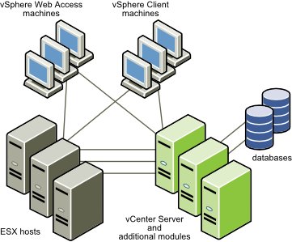
VMWare vSphere Components
Each vCenter Server system manages multiple ESX hosts. You can run the vSphere Client and vSphere Web Access on multiple workstations.
The major VMware vSphere components are:
VMware ESX : Provides a virtualization layer that abstracts the processor, memory, storage, and networking resources of the physical host into multiple virtual machines.
vCenter Server: A service that acts as a central administration point for ESX/ESXi hosts connected on a network. This service directs actions on the virtual machines and the hosts. The vCenter Server is the working core of vCenter.

Slide 24
VMware vSphere Components
vCenter Server additional modules : Provide additional capabilities eg. vCenter Update Manager, vCenter Converter, and vCenter Guided Consolidation Service and features to vCenter Server.
vSphere Client : Installs on a Windows machine and is the primary method of interaction with VMware vSphere. The vSphere Client acts as a console to operate virtual machines and as an administration interface into the vCenter Server systems and ESX hosts.
VMware vSphere Web Access : A browser-based interface for system administrators who need to access virtual machines remotely or without a vSphere Client.
Databases : Organize all the configuration data for the VMware vSphere environment.

Slide 25
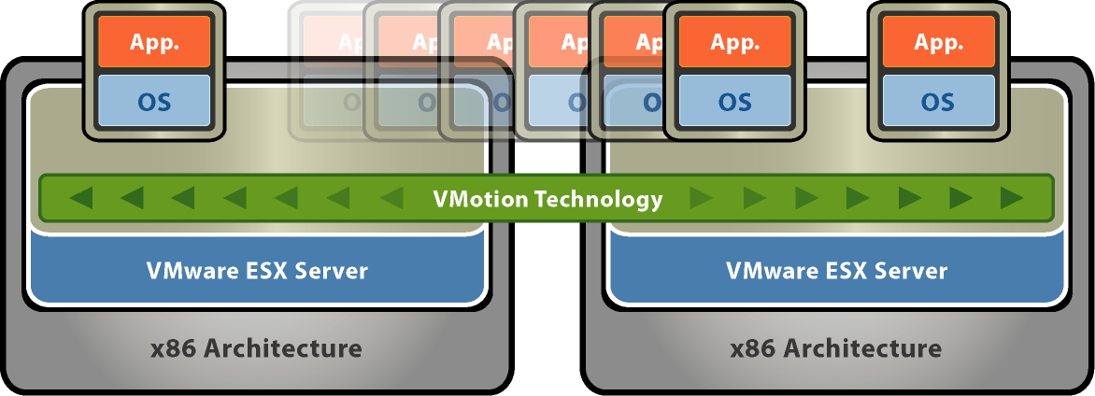
VMotion
VMotion allows you to quickly move an entire running virtual machine from one host to another without any downtime or interruption to the virtual machine This is also known as a “hot” or “live” migration.

Slide 26
VMotion
The entire state of a virtual machine is encapsulated and the VMFS file system allows both the source and the target ESX host to access the virtual machine files concurrently. The active memory and precise execution state of a virtual machine can then be rapidly transmitted over a high speed network. The virtual machine retains its network identity and connections, ensuring a seamless migration process.

Slide 27
VMotion Operations
Migration request is made to move the virtual machine from ESX1 to ESX2.
vCenter Server verifies that the virtual machine is in a stable state on ESX1 and checks the compatibility of ESX2 (CPU, networking, etc.) to ensure that it matches that of ESX1.
The virtual machine is registered on ESX2.
The virtual machine state information (including memory, registers and network connections) is copied to ESX2. Additional changes are copied to a memory bitmap on ESX1.
The virtual machine is quiesced on ESX1 and the memory bitmap is copied to ESX2.
The virtual machine is started on ESX2 and all requests for the virtual machine are now directed to ESX2.
A final copy of the virtual machines memory is done from ESX1 to ESX2.
The virtual machine is un-registered from ESX1.
The virtual machine resumes operation on ESX2.

Slide 28
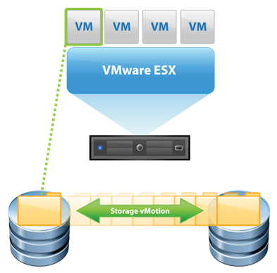
Storage VMotion
Storage VMotion is a feature introduced in ESX 3.5, it allows you to migrate a running virtual machine and its disk files from one datastore to another on the same ESX host .
The difference between VMotion and Storage VMotion is that VMotion simply moves a virtual machine from one ESX host to another but keeps the storage location of the VM the same, Storage VMotion on the other hand changes the storage location of the virtual machine while it is running and moves it to another datastore on the same ESX host. The virtual machine can be moved to any datastore on the ESX host which includes local and shared storage.

Slide 29
Storage VMotion Operations
New virtual machine directory is created on the target datastore, virtual machine configuration files and all non-virtual disk files are copied to the target directory.
ESX host does a “self” VMotion to the target directory.
A snapshot (without memory) is taken of the virtual machines disks in the source directory.
Virtual machine disk files are copied to the target directory.
Snapshot that is located in the source directory is consolidated into the virtual machine disk files located in the target directory.
Source disk files and directory are deleted.

Slide 30
VMware ESX Network Architecture in a Nutshell
Mgmt Network
Production Network
App.
App.
App.
Console OS
VM Kernel Network
OS
OS
OS
ESX Server Host
Virtual Machines
VM Virtualization Layer
Physical Hardware
CPU
Memory
…
Notes:
Describe VMWare Network Architecture

Slide 31
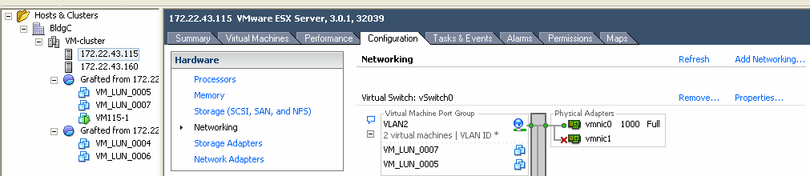
VMware Networking Components
Per ESX Server Configuration
VMs
vSwitch
VMNICS = Uplinks
vNIC
vSwitch0
VM_LUN_0007
vmnic0
VM_LUN_0005
vNIC
vmnic1
Virtual Ports

Slide 32
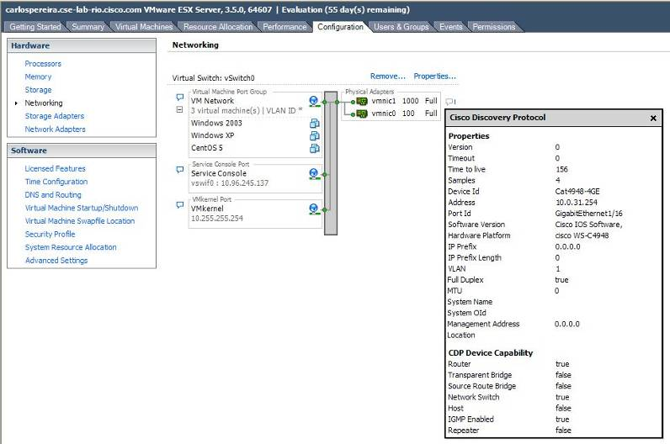
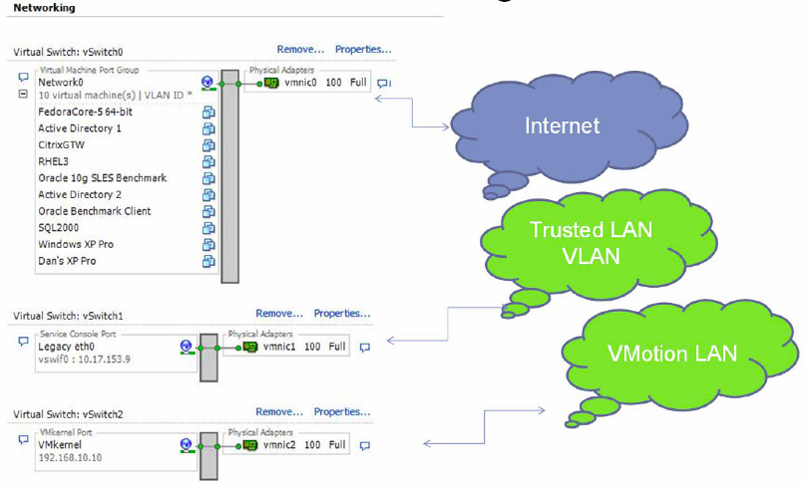
VMware Networking Components (Cont.)

Slide 33
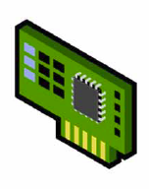

vSwitch Overview
Software implementation of an Ethernet switch within ESX
How is it like a switch:
-MAC addr forwarding
VLAN segmentation
How is it different:
-No need to learn MAC addresses – it knows the address of the connecting vNIC’s
-No participation in spanning tree
ESX
Server
VM1
VM2
Service
Console
Virtual NIC’s
X
VMkernel
NIC
VSwitch A
VSwitch B
No Trunk
Btwn vSwitch
VMkernel
No Loop
X
X
Physical NIC’s
No Loop
In ESX
Without a bridging VM
Physical
Switches
Notes:
Loops are not possible within the same vSwitch. Two vSwitches cannot be trunked. Loops are not possible within ESX without a bridging VM.

Slide 34
vSwitch Forwarding Characteristics
Forwarding based on MAC address (no learning): If traffic doesn’t match a VM MAC is sent out to vmnic
VM-to-VM traffic stays local
Vswitches TAG traffic with 802.1q VLAN ID
vSwitches are 802.1q-capable
vSwitches can create EtherChannels

Slide 35
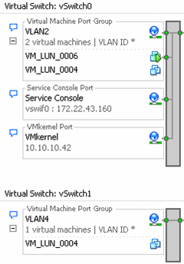
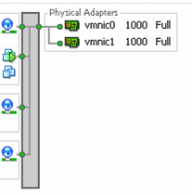
Meaning of NIC Teaming in VMware (2)
Teaming is Configured at
The vmnic Level
This is NOT Teaming

